Slide 1


Artificial Intelligence (Machine Learning & Deep Learning)
NAVTCC & Strings Technologies
by Salman Ahmad

Slide 2
Outline Week 2 Day 4
Measures of Dispersion
1
2
Variance, Standard deviation
Co-efficient of variation, skewness and
kurtosis
3
4
Measures of Position
Z-Score, Percentile, Quartile
4

Slide 3
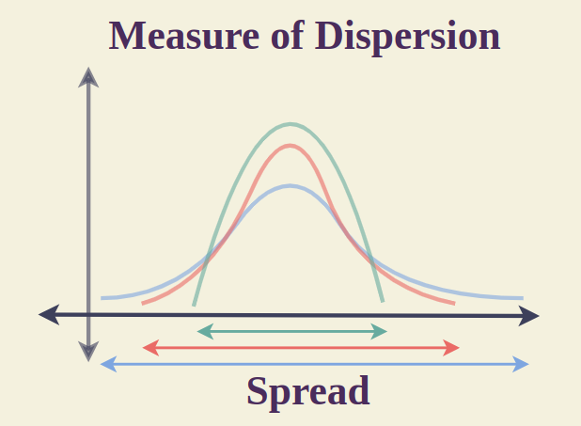
Measures of Dispersion in Statistics
What Are Measures of Dispersion?
They quantify how much data varies around a central point (like the mean or median).
They help answer:
Are the data values tightly clustered or widely spread out?

Slide 4
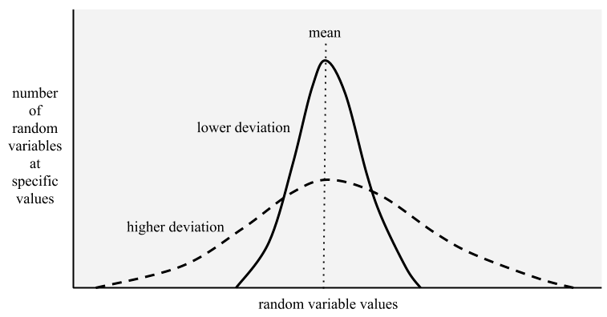
Variance (σ²)
The average of the squared differences from the mean
Measures how much values deviate (spread) from the mean
σ² = Σ (xᵢ - μ)² / N
μ: mean
N: number of values
np.var(data)

Slide 5
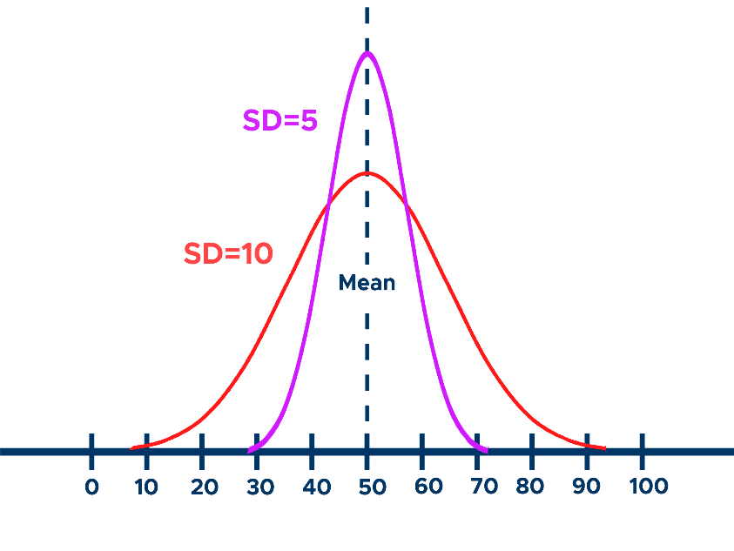
Standard Deviation (σ)
The square root of variance
Most commonly used measure of spread in datasets
Same units as the data itself
np.std(data)
Lower std dev = tighter clustering,
Higher std dev = more spread out data

Slide 6
Standard Deviation (σ)
Describing data: It provides a descriptive statistic about the variability in a dataset.
Comparing datasets: It helps compare the variability of different datasets.
Assessing risk: In finance, it's used as a measure of risk, with higher standard deviation indicating greater volatility.
Statistical analysis: It's a crucial component in various statistical analyses and hypothesis testing.

Slide 7
Coefficient of Variation (CV)
Measures the relative variability of data
CV is a standardized measure independent of the units of measurement
Ratio of standard deviation to mean (unitless)
Useful for comparing spread across datasets with different scales
cv = np.std(data) / np.mean(data)
Lower CV → less variability
Often used in finance, manufacturing, biology
CV = (σ / μ) × 100%

Slide 8
Coefficient of Variation (CV)
A CV of 0 indicates no variability, meaning all data points are identical to the mean.
A CV greater than 1 (or 100%) indicates high variability, suggesting that the data points are widely dispersed from the mean.
A CV less than 1 (or 100%) suggests lower variability, indicating the data points are clustered closer to the mean

Slide 9
Skewness (Asymmetry of Distribution)
Measures whether data is symmetrically distributed
Helps detect outliers and bias
In Python:
from scipy.stats import skew
skew(data)

Slide 10
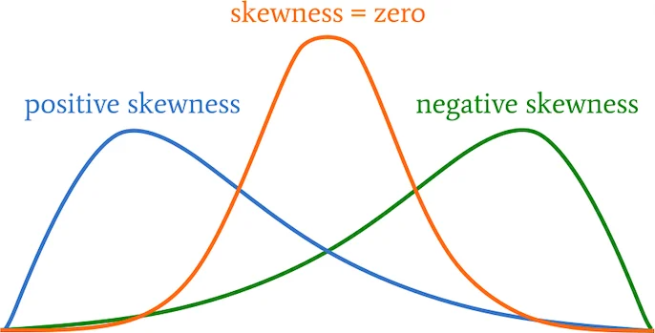
Skewness (Asymmetry of Distribution)
Skewness Value | Interpretation
≈ 0 | Symmetric distribution
> 0 | Right skew (long tail to the right)
< 0 | Left skew (long tail to the left)

Slide 11
Kurtosis (Tailedness / Peakness)
Measures the "tailedness" or peakiness of the distribution
Tells if data has heavy or light tails compared to normal distribution
In python:
from scipy.stats import kurtosis
kurtosis(data)

Slide 12
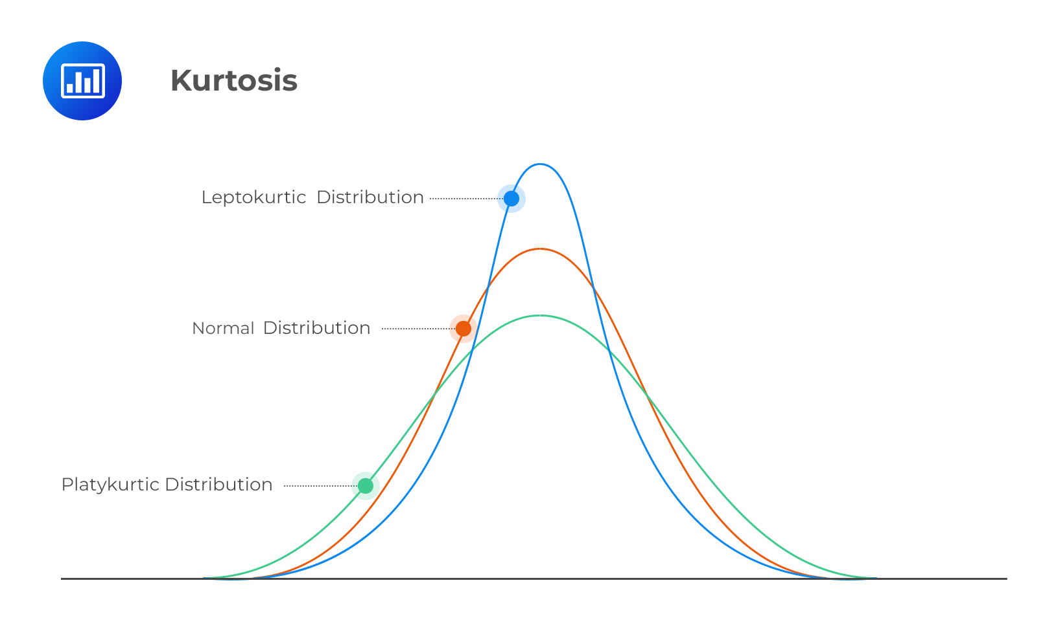
Kurtosis (Tailedness / Peakness)
Kurtosis Value | Interpretation
≈ 3 | Normal distribution
> 3 | Leptokurtic (heavy tails, sharp peak)
< 3 | Platykurtic (light tails, flatter peak)

Slide 13
Measure of dispersion
Measure | Description | Key Insight
Variance | Avg squared deviation from mean | Raw measure of spread
Std Deviation | Square root of variance | Spread in original units
Coefficient of Var | Std dev relative to mean | Spread comparison across scales
Skewness | Asymmetry of distribution | Outliers, bias detection
Kurtosis | Tailedness or peakiness | Risk or anomaly sensitivity

Slide 14
Practice Task
– Download prices.npy from google classroom
– Load in numpy
– Calculate variance, standard deviation
– Compute CV
– Determine skewness and kurtosis
– Visualize data using histogram or boxplot
– Interpret whether data is normal, skewed, or has outliers

Slide 15
Measures of Position
What Are Measures of Position?
They tell you where a particular data point stands in the dataset
Answer questions like:
Is this value low, average, or unusually high compared to others?
percentiles, quartiles, and z-scores

Slide 16
Z-Score (Standard Score)
Measures how many standard deviations a value is from the mean
Used to detect outliers and normalize data
Z = (X - μ) / σ
A z-score of 0 means the data point is equal to the mean.
Positive z-scores indicate the data point is above the mean, while negative z-scores indicate it's below the mean
In Python:
from scipy.stats import zscore
zscore(data)

Slide 17
Understanding Percentiles
A percentile is the value below which a given percentage of observations in a dataset falls.
It answers:
"What value marks the bottom X% of the data?"
Percentile vs Percentage
Percentage: Your score (e.g., you got 80 out of 100)
Percentile: Your position (e.g., you scored higher than 80% of others)

Slide 18
Understanding Percentiles
import numpy as np
data = [10, 20, 30, 40, 50, 60, 70, 80, 90, 100]
p25 = np.percentile(data, 25) # Q1
p50 = np.percentile(data, 50) # Median
p75 = np.percentile(data, 75) # Q3
print("25th Percentile:", p25)
print("50th Percentile (Median):", p50)
print("75th Percentile:", p75)

Slide 19
Quartiles
Quartiles divide an ordered dataset into four equal parts, each containing 25% of the data.
Help identify the spread and distribution of the dataset.
Quartile | Also Called | Percentile Equivalent | Meaning
Q1 | First Quartile | 25th Percentile | 25% of data is below this value
Q2 | Second Quartile | 50th Percentile (Median) | 50% below
Q3 | Third Quartile | 75th Percentile | 75% below

Slide 20
Interquartile Range
IQR = Q3 − Q1
Measures the middle 50% spread
Used to detect outliers:
lower_bound = Q1 - 1.5 * IQR
upper_bound = Q3 + 1.5 * IQR

Slide 21
Interquartile Range
What is the 1.5 in the IQR method?
It comes from Tukey's method in exploratory data analysis
It’s a multiplier used to define how far a value can be from the interquartile range (IQR) before it’s considered an outlier.
The choice of 1.5×IQR helps capture most of the “typical” values while flagging extreme ones.

Slide 22
Practice Task
1. Download prices.npy from google classroom
2. Load using numpy
3. Calculate Q1, Q2, Q3
4. Find the IQR
5. Determine if any values are outliers (use IQR method)

Slide 23

Questions?
"He who asks a question is a fool for a minute; he who does not remains a fool forever." – Confucius

